Slide 1


Data Science: Organization
Yes, the Mascot is a Panda
Notes:
sudo pip3 install pandas
1 min

Slide 2
Pandas – How Does it Work?
Pandas shares similarities with other data organization packages.
A series is a set of data points with indices (e.g., column)
A data frame is a set of series with shared indices (e.g., table)
Indices often represent a unique sample in a data set
Each index defines a row in the data frame
Pandas, like SciPy, is built on top of Numpy – so it’s also very fast!
Notes:
2.5 min

Slide 3
Pandas Basics
In Pandas, series and data frames are built as class-based objects.
import pandas
# Set up example values for a few students
students = ["Anna", "Benny", "Caroline"]
scores1 = [82, 75, 98]
scores2 = [88, 70, 95]
# Display an example with default indices
example = pandas.Series(scores1)
print("Series\n--------\n%s\n" % example)
# Create series with student names as indices
exam1 = pandas.Series(scores1, name="E1", index=students)
print("Exam 1\n--------------\n%s\n" % exam1)
# Create series for Exam 2, then a data frame for exams
exam2 = pandas.Series(scores2, index=students)
grade_data = {"Exam1": exam1, "Exam2": exam2}
grades = pandas.DataFrame(grade_data)
print("Grades\n----------------------\n%s\n" % grades)
Series
--------
0 82
1 75
2 98
dtype: int64
Exam 1
--------------
Anna 82
Benny 75
Caroline 98
Name: E1, dtype: int64
Grades
----------------------
Exam1 Exam2
Anna 82 88
Benny 75 70
Caroline 98 95
Notes:
7.5 min

Slide 4
DataFrame Indexing
We can get or set DataFrame elements, rows, and columns via indexing.
import pandas
# Set up example values for a few students
exams = ["Exam 1", "Exam 2"]
names = ["Carol", "Ben", "Eve", "Dan", "Fred", "Ann"]
scores = [[95,98], [75,70], [67,77], [82,88], [0,0], [75,88]]
grades = pandas.DataFrame(scores, index=names, columns=exams)
# Indices and columns (IMMUTABLE)
print("Columns:", grades.columns)
print("Indices:", list(grades.index), "\n")
# Indexing - can also be used to set values / columns (MUTABLE)
print("Ann, Exam 1:", grades["Exam 1"]["Ann"])
# We can also index rows / columns / subsets directly (VIEW)
print("\nExam 1 Grades\n-------------\n%s\n" % grades["Exam 1"])
print("Ann's Grades\n------------\n%s\n", grades["Ann":"Ann"]))
Columns: Index(['Exam 1', 'Exam 2'], dtype='object')
Indices: ['Ann', 'Ben', 'Carol', 'Dan', 'Eve', 'Fred’]
Ann, Exam 1: 75
Exam 1 Grades
-------------
Carol 95
Ben 75
Eve 67
Dan 82
Fred 0
Ann 75
Name: Exam 1, dtype: int64
Ann's Grades - [82, 88]
-----------------------
Exam 1 Exam 2
Ann 75 88
Notes:
10.5 min

Slide 5
Data Access Methods
We can also get a subset of the data frame’s information via special methods.
import pandas
# Set up example values for a few students
exams = ["Exam 1", "Exam 2"]
names = ["Carol", "Ben", "Eve", "Dan", "Fred", "Ann"]
scores = [[95,98], [75,70], [67,77], [82,88], [0,0], [75,88]]
grades = pandas.DataFrame(scores, index=names, columns=exams)
# Print head (VIEW or COPY; use grades[0:5] for VIEW)
print("Grades (Head)\n%s\n%s\n" % ("-" * 21, grades.head()))
# Print tail – (VIEW or COPY; use grades[4:6] for VIEW)
print("Grades (Tail)\n%s\n%s\n" % ("-" * 21, grades.tail(2)))
# Transposed version of a data frame (VIEW, unless copy=True)
tail = grades.tail(2)
print("Transposed Tail\n%s\n%s\n" % ("-" * 15, tail.T))
# Get numpy array (VIEW, unless copy=True)
print("Tail-to-Numpy: [%s %s]" % tuple(tail.to_numpy()))
grades.to_csv("grades.csv")
Grades (Head)
---------------------
Exam 1 Exam 2
Carol 95 98
Ben 75 70
Eve 67 77
Dan 82 88
Fred 0 0
Grades (Tail)
---------------------
Exam 1 Exam 2
Fred 0 0
Ann 75 88
Transposed Tail
---------------
Fred Ann
Exam 1 0 75
Exam 2 0 88
Tail-to-Numpy: [[0 0] [75 88]]
Notes:
5.5 min

Slide 6
Basic Data Processing
Of course, we want to be able to manipulate the data, too.
import pandas
# Read CSV file containing grade information
grades = pandas.read_csv("grades.csv", index_col=0)
# Prepare summary information as a DataFrame (new data)
print(grades.describe(), "\n")
# Print reverse-sorted tail (COPY, unless inplace=True)
grades = grades.sort_index()
print(“Sorted Tail\n-------------\n%s\n" % grades.tail(2))
# Print grade-sorted head (COPY, unless inplace=True)
sort_by = ["Exam 1", "Exam 2"] # Eq.: list(grades.columns)
grade_sorted = grades.sort_values(sort_by, 0, False).head(3)
print("Grade Sorted\n------------\n%s\n" % grade_sorted)
# Add a name to the index, then save as pickle file
name_list = ["Ann", "Ben", "Carol", "Dan", "Eve", "Fred"]
grades.index = pandas.Index(name_list, name="Name")
grades.to_pickle("grades.pickle")
Exam 1 Exam 2
count 6.000000 6.000000
mean 65.666667 70.166667
std 33.512187 35.723475
min 0.000000 0.000000
25% 69.000000 71.750000
50% 75.000000 82.500000
75% 80.250000 88.000000
max 95.000000 98.000000
Reversed Tail
-------------
Exam 1 Exam 2
Eve 67 77
Fred 0 0
Grade Sorted
------------
Exam 1 Exam 2
Carol 95 98
Dan 82 88
Ann 75 88
Notes:
Excel requires either openpyxl or xlrd / xlwt!
6 min (10 min?)

Slide 7
Data Classification
We can generate histogram data and other useful tables of information.
import pandas
# Load grades from pickle file
grades = pandas.read_pickle("grades.pickle")
# Add experience type series to grades DataFrame
grades["Exp"] = ["Blocks", "Text", "Text", "None", "None", "None"]
print("GRADES, WITH PRIOR EXPERIENCE\n%s\n" % grades)
# Histograms (counts) of experience
count_table = grades["Exp"].value_counts()
print("COUNT BY PRIOR EXPERIENCE\n%s\n" % count_table)
# Pivot table of average exam grades by experience level
table = pandas.pivot_table(grades, values=["Exam 1", "Exam 2"], index="Exp")
print("PIVOT TABLE, MEAN SCORE BY EXP\n%s\n" % table)
# Save to Excel spreadsheet
grades.to_excel("grades.xlsx", sheet_name="Grades")
GRADES, WITH PRIOR EXPERIENCE
Exam 1 Exam 2 Exp
Name Ann 75 88 Blocks
Ben 75 70 Text
Carol 95 98 Text
Dan 82 88 None
Eve 67 77 None
Fred 0 0 None
COUNT BY PRIOR EXPERIENCE
None 3
Text 2
Blocks 1
Name: Exp, dtype: int64
PIVOT TABLE, MEAN SCORE BY EXP
Exam 1 Exam 2
Exp
Blocks 75.000000 88
None 49.666667 55
Text 85.000000 84
Notes:
Note: Reading html requires lxml or html5lib!
6.5 min

Slide 8
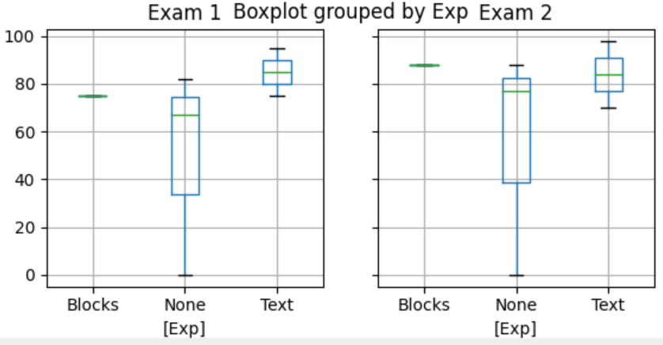
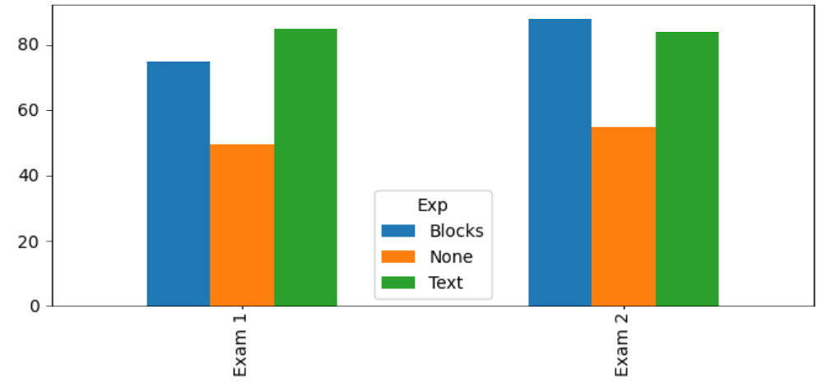
Using with other Packages
Pandas integrates with matplotlib, SciPy, and other suites.
import pandas, scipy
from matplotlib import pyplot
from scipy import stats
# Load the Excel data and show a box plot split by experience
grades = pandas.read_excel("grades.xlsx", sheet_name="Grades", index_col="Name")
grades.boxplot(by="Exp")
pyplot.show()
# Bar graph of student grades by experience type
grades.groupby("Exp").mean().T.plot.bar()
pyplot.show()
# Print ANOVA
blocks = grades[grades["Exp"] == "Blocks"]
print("ANOVA F: %d; p: %d" % stats.f_oneway(blocks["Exam 1"], blocks["Exam 2"]))
ANOVA F: 0; p: 0
See statsmodels package for more goodies!
Notes:
7 min

